Slide 1

Tree.st

Slide 2




Tree.st / Macro vs. Micro Qualities
Macro
BAR State
Disease
Gender
Education
Insurance
Age
Practice
Medicine
Location
Micro
Lawyer
Patient
Consumer
Personality
Economic
Left-handed
Judges
Family?
Borrow?
Cases
Side-effects
Loves…
Work Style
Prevalence
Traveled to
…
Tree.st
…

Slide 3
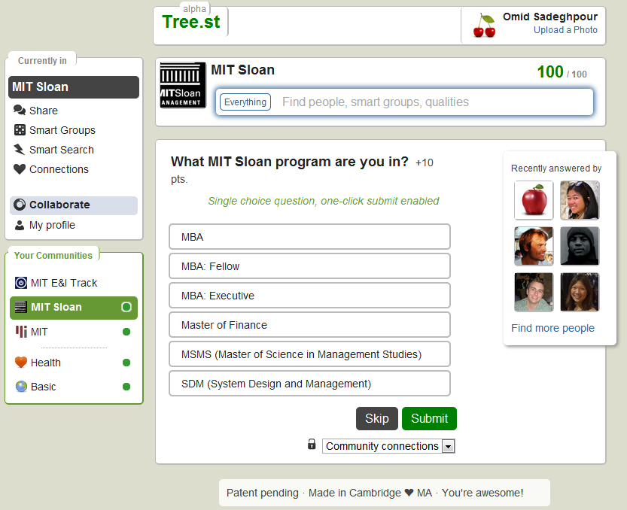
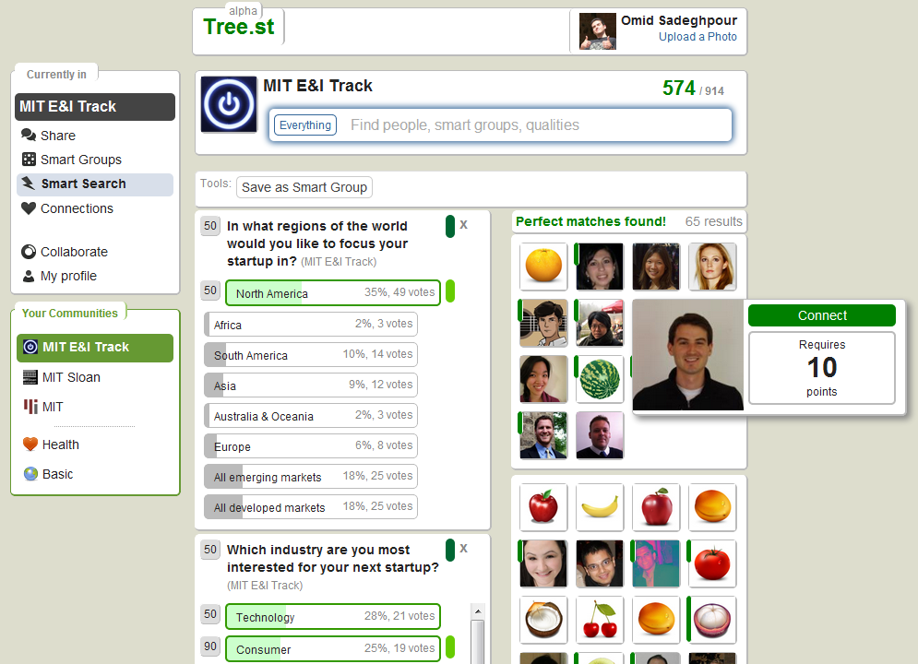
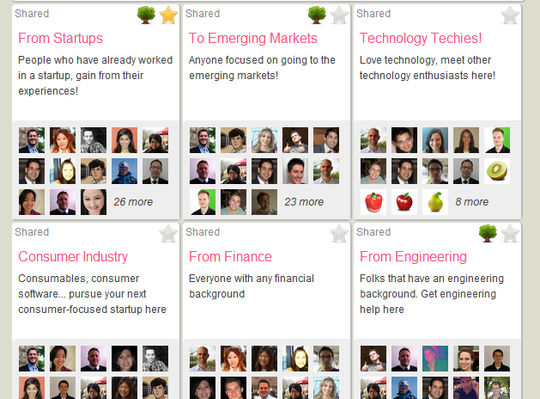
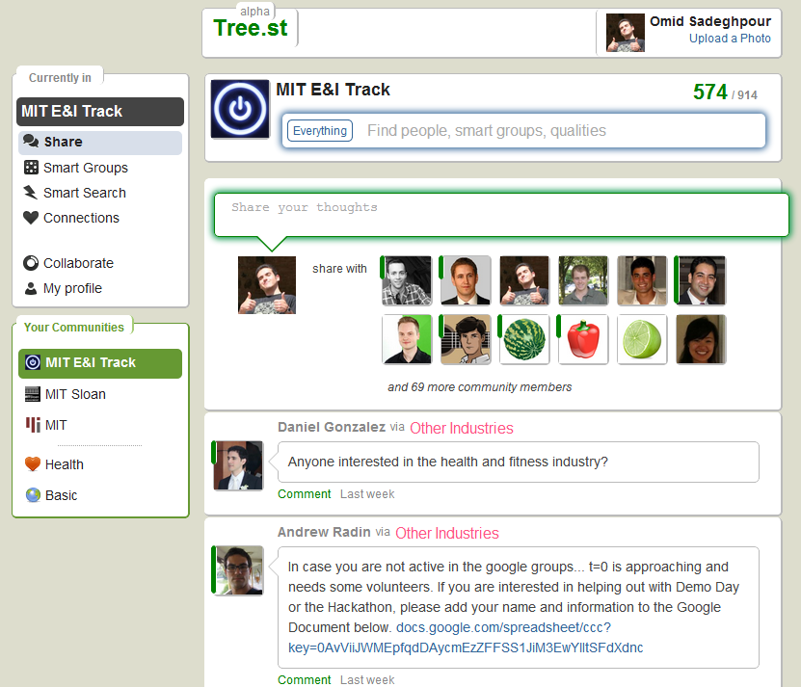
Tree.st / How we do it
GATHER
SEARCH
GROUPING
SHARE / COMM.
Via a decision tree of questions we quickly gather the unique attributes for each user in a community
Enable search user to search for one another based on the same unique attributes of the community
With our patent-pending “smart groups” we automatically place users in groups based on their unique qualities
Tree.st enables community members to broadcast messages in smart groups, similar to a mailing list with many digest features
(Appendix A)
(Appendix B)
(Appendix C)
(Appendix D)
SAFE & SECURE
In a platform that ensures data safety, anonymity when needed, de-centralization, security and redundancy
INTELLECTUAL PROPERTY
Submitted a provisional patent application 07/02/2012, and two landscape studies by 10/30/2012

Slide 4
Tree.st / Validation
MIT SLOAN
Characterized 40% of MIT Sloan (400+ Students)
Gathered 45 unique attributes never before stored in one platform, without any funding
Automatically categorized students in 20+ “smart groups”
Students began communicating by email about recruiting, going out, gluten-free ideas, startups, etc
ENTREPRENEURSHIP & INNOVATION TRACK
Before classes began Tree.st had already automatically
grouped all the students using 13 unique attributes
By the first class 80% of the students were on the E&I Tree.st community
Entrepreneurs quickly began communicating and brainstorming
UPCOMING COMMUNITIES
VMS Mentors (i.e.: you), 20Under20, MIT Energy Club, Mobile Monday

Slide 5
Tree.st / Market
MARKET SIZE
Characterized 40% of MIT Sloan (400+ Students)
PROFITABILITY
VERTICALS
COMPETITIVE LANDSCAPE
User
Profiles
Device
Proposition
Market
Trends &
Research
Technical
Study
Project
Mission
UX
Principles
Customer
Insight
Business
Objectives

Slide 6
Tree.st / Looking for…
Two or three paying customers
Mentors familiar with online social space, enterprise space, or familiar with the different market verticals we will approach
Funding: $2M for May 2013

Slide 7
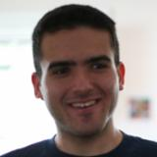
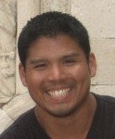
Tree.st / Team
Omid Sadeghpour (Co-founder)
Co-founder. BS Engineering UC Berkeley. Startups: Applied Proteomics Inc. (Series B: $22.5M), Dailysite.com. Programming for 10+ yrs. MIT Sloan MBA ‘13
Tung Shin Wong
Lead User Experience Designer at Method
6 yrs. Consumer Experience Design Mobile and Internet. Ravensbourne College of Design and Communication BA (Hons), Interaction Design
Alex Sanchez (Co-founder)
Co-founder. Former Head of Product Innovation, Orange / France Telecom.
10+ yrs. Consumer Mobile and Internet Services - Product design, Product Mgmt.
MIT Sloan MBA ‘13
Yu Xin
PhD Student – Data Analytics
Machine Learning Group Computer Science and Artificial Intelligence (CSAIL) Lab, MIT
Adam Borelli
Lorem doreuasdf asdflkjadf asd w2r asd fa fawe as fas f 23lkrjasdlfj 23lkj ladfj l;kj34rl53k1j4 lkajsdf l;k2j34l;k1j lkdjf al;sdfjasflj asdl;fkjlk jasdf
Akash Badshah
Software Developer – Web and Mobile
BS Computational Biology and Physics ‘13, MIT
Alexander Romanov
Lorem doreuasdf asdflkjadf asd w2r asd fa fawe as fas f 23lkrjasdlfj 23lkj ladfj l;kj34rl53k1j4 lkajsdf l;k2j34l;k1j lkdjf al;sdfjasflj asdl;fkjlk jasdf
Victor D. Pontis
Software Developer – Web and Mobile
BS Computational Biology and Physics ‘13, MIT

Slide 8
Tree.st / Appendix A

Slide 9
Tree.st / Appendix B

Slide 10
Tree.st / Appendix C

Slide 11
Tree.st / Appendix D

Slide 12
Tree.st / Appendix E

